Slide 1
Falstad
Circuit Simulator

Slide 2
Falstad Circuit Simulator
Falstad Circuit Simulator is a
free
browser-based
electronics simulation tool that lets you design and test electrical and electronic circuits interactively.
It’s often called "Falstad" because it was created by Paul Falstad.

Slide 3
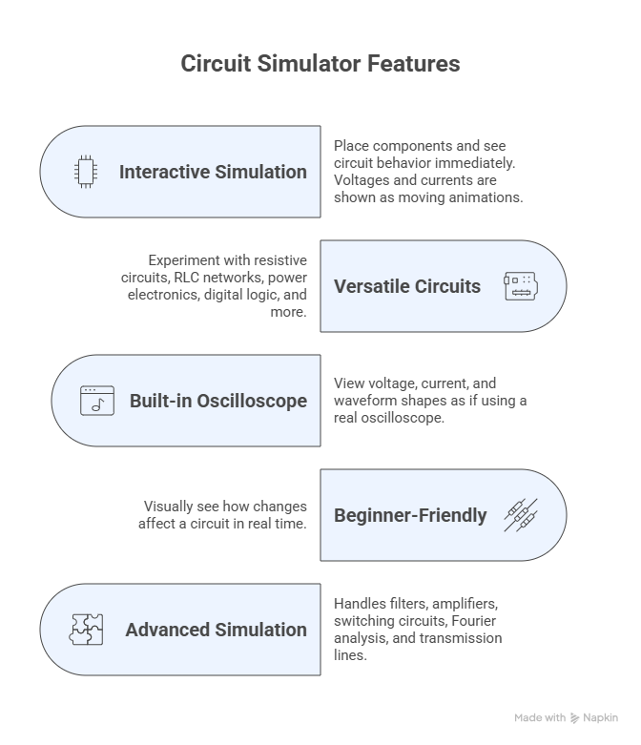
Key Features

Slide 4
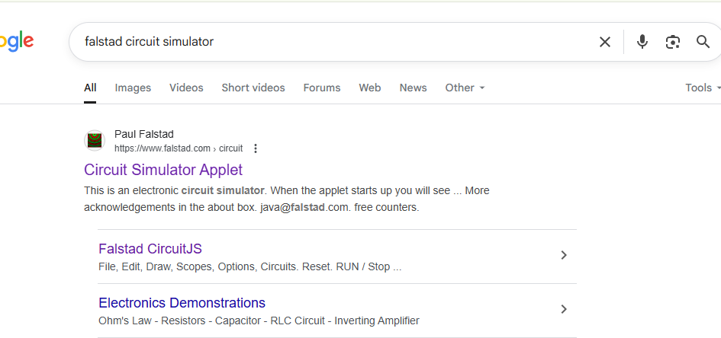
How to Access It?
Web version: https://falstad.com/circuit/
No installation needed

Slide 5
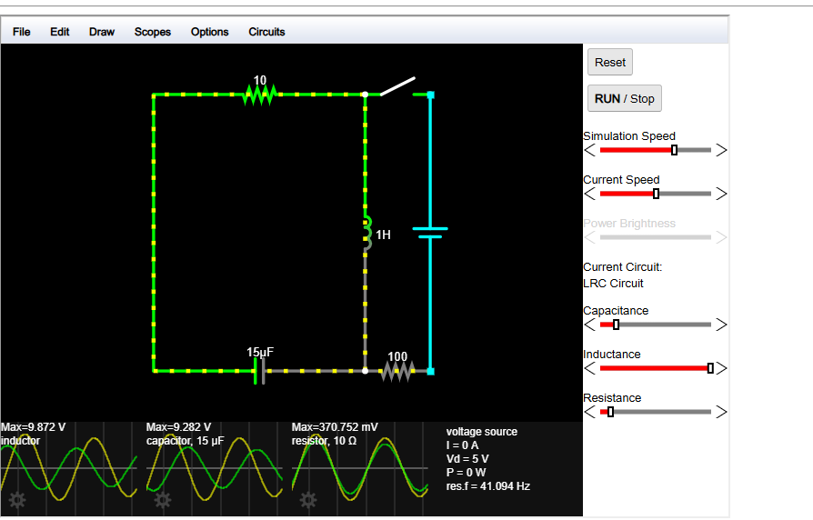

Slide 6
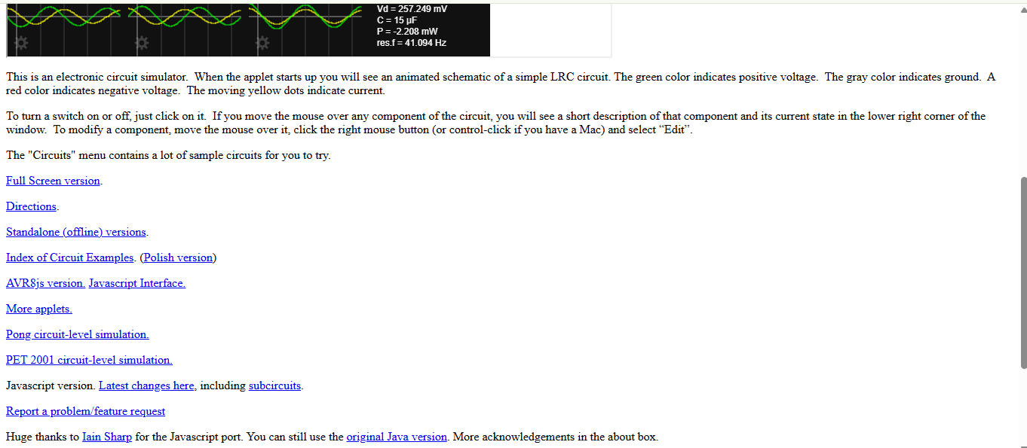

Slide 7
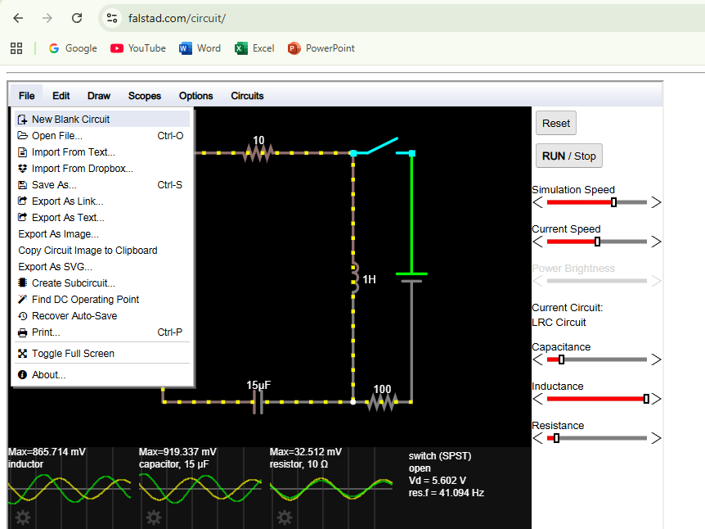

Slide 8
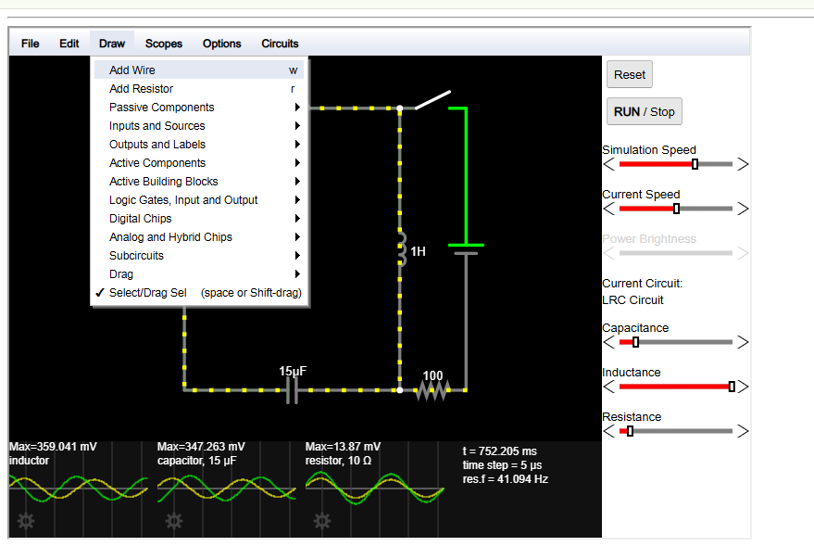

Slide 9
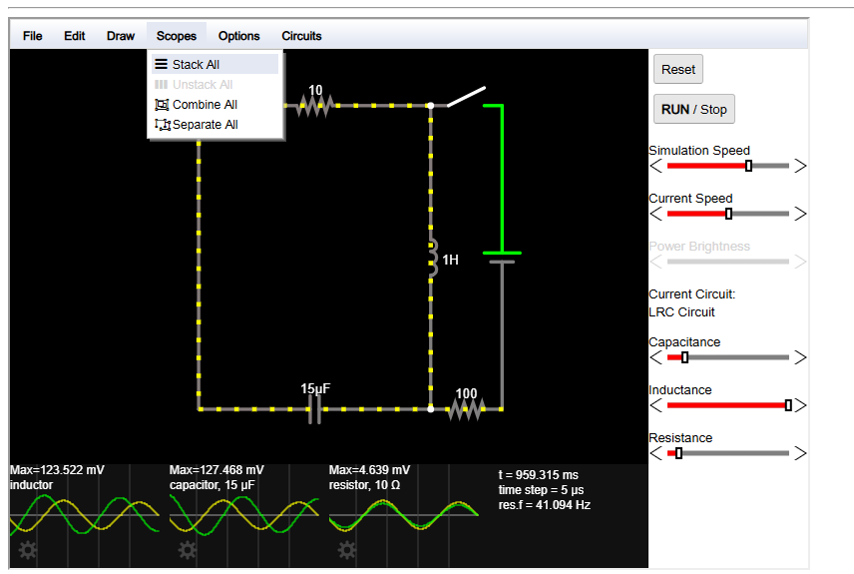

Slide 10
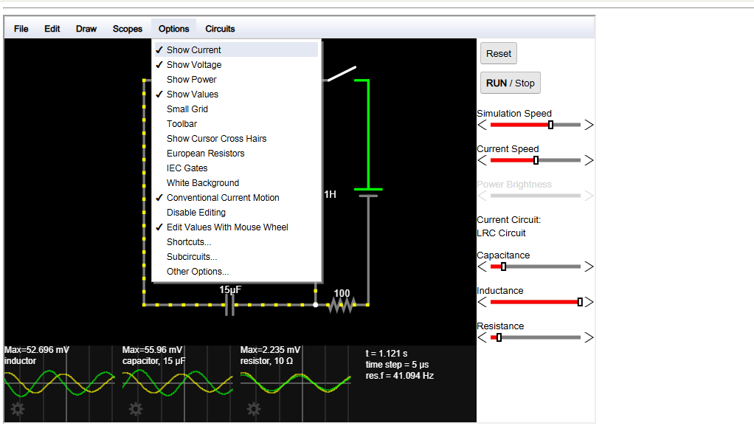

Slide 11
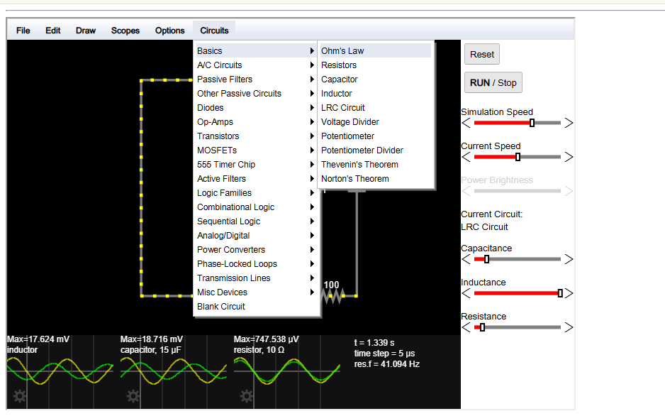

Slide 12
Falstad Circuit Simulator Algorithm
Initialize: Number nodes, initialize voltages, capacitor voltages, inductor currents, and timestep.
Update dynamic element : Convert capacitors and inductors into equivalent resistances/current sources for this time step.
Linearize nonlinear devices: Apply Newton–Raphson iteration for diodes, transistors, etc.
Assemble Circuit Equation matrix and solve : Include resistors, voltage/current sources, dynamic equivalents, and linearized nonlinear elements and Compute node voltages.
Update time-dependent states: Capacitor voltages and inductor currents for the next timestep.
Render visualization: Node voltages (color), branch currents (animated dots), waveforms.
Advance time: Repeat steps 2–8 until simulation end.

Slide 13
Exercise
An underground parking lot uses LED floodlights powered by a 24 V DC supply from a battery bank.
Each floodlight module has two identical LEDs in series inside its housing, each with a resistance of 5 Ω
There are four floodlight modules connected in parallel to the supply. The cables from the battery bank to the lights have a total resistance of 0.5 Ω The maintenance engineer needs to determine:
The total current drawn from the battery.

Slide 14
A sine wave passes through a diode /half-wave rectifier, then through an RC circuit
What happens: The integrator smooths the rectified pulses, producing a DC-like output.
Falstad setup: Add AC sine source → diode → resistor → capacitor

